Slide 1
Programming Fundamentals
Chapter 4 - Java Scanner & Decision Making
Chapter 4

Slide 2
Java Scanner

Slide 3
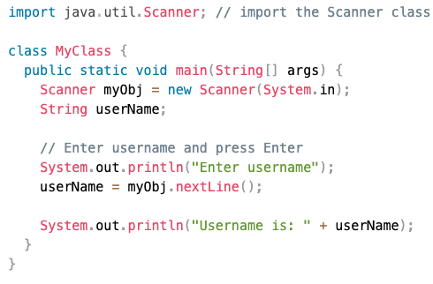
Java User Input
The Scanner class is used to get user input, and it is found in the java.util package.

Slide 4
Java Decision Making

Slide 5
Java - Decision Making
Decision making structures have one or more conditions to be evaluated or tested by the program, along with a statement or statements that are to be executed if the condition is determined to be true, and optionally, other statements to be executed if the condition is determined to be false.
Java programming language provides following types of decision making statements.
1-if statement
2-if…else statement
3-switch statement

Slide 6
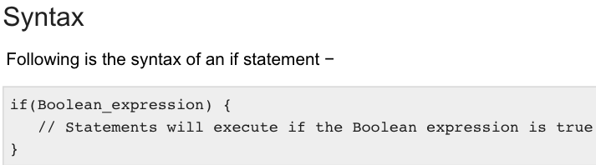
1- if statement in java
An if statement consists of a Boolean expression followed by one or more statements.

Slide 7
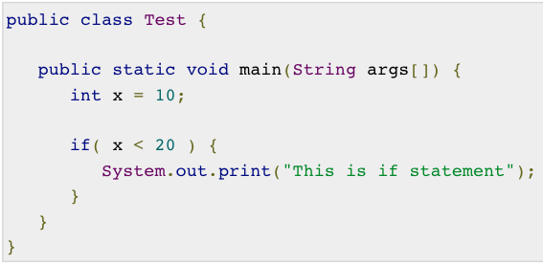
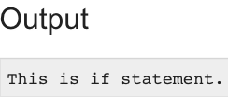
Example

Slide 8
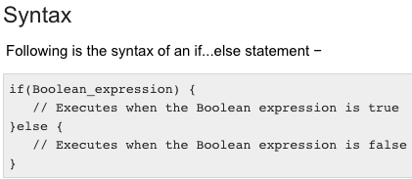
2- if-else statement in java
An if statement can be followed by an optional else statement, which executes when the Boolean expression is false.

Slide 9
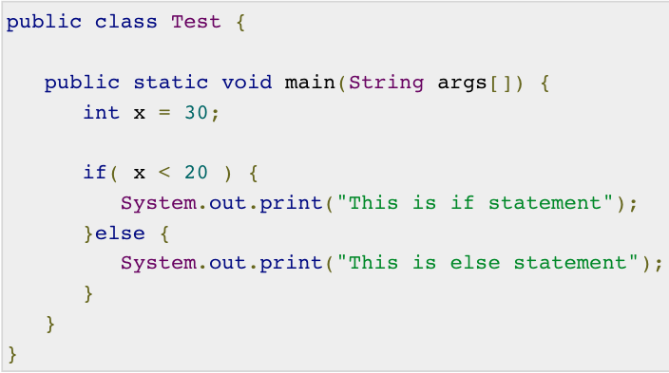
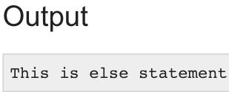
Example

Slide 10
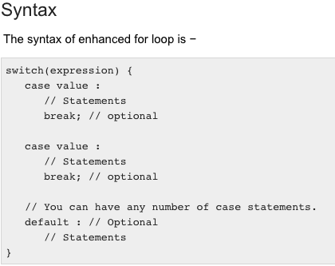
3- Switch statement in java
A switch statement allows a variable to be tested for equality against a list of values. Each value is called a case, and the variable being switched on is checked for each case.

Slide 11
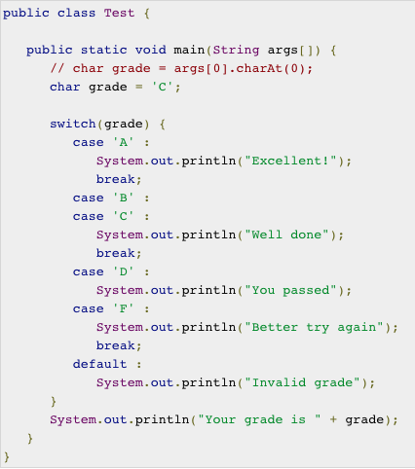
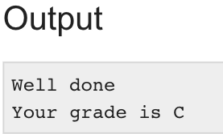
Example

